Slide 1
Data Mining
Chapter 5
Association Analysis: Basic Concepts

Slide 2
Support Counting of Candidate Itemsets
Scan the database of transactions to determine the support of each candidate itemset
Must match every candidate itemset against every transaction, which is an expensive operation

Slide 3
Support Counting of Candidate Itemsets
To reduce number of comparisons, store the candidate itemsets in a hash structure
Instead of matching each transaction against every candidate, match it against candidates contained in the hashed buckets

Slide 4
Support Counting: An Example
Suppose you have 15 candidate itemsets of length 3:
{1 4 5}, {1 2 4}, {4 5 7}, {1 2 5}, {4 5 8}, {1 5 9}, {1 3 6}, {2 3 4}, {5 6 7}, {3 4 5}, {3 5 6}, {3 5 7}, {6 8 9}, {3 6 7}, {3 6 8}
How many of these itemsets are supported by transaction (1,2,3,5,6)?

Slide 5
Support Counting Using a Hash Tree
Suppose you have 15 candidate itemsets of length 3:
{1 4 5}, {1 2 4}, {4 5 7}, {1 2 5}, {4 5 8}, {1 5 9}, {1 3 6}, {2 3 4}, {5 6 7}, {3 4 5}, {3 5 6}, {3 5 7}, {6 8 9}, {3 6 7}, {3 6 8}
You need:
Hash function
Max leaf size: max number of itemsets stored in a leaf node (if number of candidate itemsets exceeds max leaf size, split the node)
Hash function
2 3 4
5 6 7
3,6,9
1,4,7
1 4 5
3 4 5
3 5 6
3 5 7
6 8 9
3 6 7
3 6 8
1 3 6
2,5,8
1 2 4
4 5 7
1 2 5
4 5 8
1 5 9

Slide 6
Support Counting Using a Hash Tree
Hash Function
Candidate Hash Tree
1,4,7
3,6,9
2,5,8
2 3 4
5 6 7
1 4 5
1 3 6
3 4 5
3 5 6
3 6 7
Hash on 1, 4 or 7
3 5 7
3 6 8
1 2 4
1 5 9
6 8 9
1 2 5
4 5 7
4 5 8

Slide 7
Support Counting Using a Hash Tree
Hash Function
Candidate Hash Tree
1,4,7
3,6,9
2,5,8
2 3 4
5 6 7
1 4 5
1 3 6
3 4 5
3 5 6
3 6 7
Hash on 2, 5 or 8
3 5 7
3 6 8
1 2 4
1 5 9
6 8 9
1 2 5
4 5 7
4 5 8

Slide 8
Support Counting Using a Hash Tree
Hash Function
Candidate Hash Tree
1,4,7
3,6,9
2,5,8
2 3 4
5 6 7
1 4 5
1 3 6
3 4 5
3 5 6
3 6 7
Hash on 3, 6 or 9
3 5 7
3 6 8
1 2 4
1 5 9
6 8 9
1 2 5
4 5 7
4 5 8

Slide 9
Support Counting Using a Hash Tree
1 2 3 5 6
transaction
Hash Function
1 +
2 3 5 6
2 +
3 5 6
1,4,7
3,6,9
3 +
5 6
2,5,8
2 3 4
5 6 7
1 4 5
1 3 6
3 4 5
3 5 6
3 6 7
3 5 7
3 6 8
1 2 4
1 2 5
1 5 9
6 8 9
4 5 7
4 5 8

Slide 10
Support Counting Using a Hash Tree
1 2 3 5 6
transaction
Hash Function
1 +
2 3 5 6
2 +
3 5 6
1,4,7
3,6,9
1 2 +
3 5 6
3 +
5 6
2,5,8
1 3 +
5 6
2 3 4
1 5 +
6
5 6 7
1 4 5
1 3 6
3 4 5
3 5 6
3 6 7
3 5 7
3 6 8
1 2 4
1 2 5
1 5 9
6 8 9
4 5 7
4 5 8

Slide 11
Support Counting Using a Hash Tree
1 2 3 5 6
transaction
Hash Function
1 +
2 3 5 6
2 +
3 5 6
1,4,7
3,6,9
1 2 +
3 5 6
3 +
5 6
2,5,8
1 3 +
5 6
2 3 4
1 5 +
6
5 6 7
1 4 5
1 3 6
3 4 5
3 5 6
3 6 7
3 5 7
3 6 8
1 2 4
1 2 5
1 5 9
6 8 9
4 5 7
4 5 8
Match transaction against 11 out of 15 candidates

Slide 12
Rule Generation
Given a frequent itemset L, find all non-empty subsets f ⊂ L such that f → L – f satisfies the minimum confidence requirement
If {A,B,C,D} is a frequent itemset, candidate rules:
ABC →D, ABD →C, ACD →B, BCD →A, A →BCD, B →ACD, C →ABD, D →ABC AB →CD, AC → BD, AD → BC, BC →AD, BD →AC, CD →AB,
If |L| = k, then there are 2^{k} – 2 candidate association rules (ignoring L → ∅ and ∅ → L)

Slide 13
Rule Generation
In general, confidence does not have an anti-monotone property
c(ABC →D) can be larger or smaller than c(AB →D)
But confidence of rules generated from the same itemset has an anti-monotone property
E.g., Suppose {A,B,C,D} is a frequent 4-itemset: c(ABC → D) ≥ c(AB → CD) ≥ c(A → BCD)
Confidence is anti-monotone w.r.t. number of items on the RHS of the rule

Slide 14
Rule Generation for Apriori Algorithm
Lattice of rules
Low Confidence Rule
Pruned Rules

Slide 15
Association Analysis: Basic Concepts and Algorithms
Algorithms and Complexity

Slide 16
Factors Affecting Complexity of Apriori
Choice of minimum support threshold
Dimensionality (number of items) of the data set
Size of database
Average transaction width

Slide 17
Factors Affecting Complexity of Apriori
Choice of minimum support threshold
lowering support threshold results in more frequent itemsets
this may increase number of candidates and max length of frequent itemsets
Dimensionality (number of items) of the data set
Size of database
Average transaction width

Slide 18
Impact of Support Based Pruning
Items (1-itemsets)
Minimum Support = 3
Minimum Support = 2
If every subset is considered,
⁶C₁ + ⁶C₂ + ⁶C₃
6 + 15 + 20 = 41
With support-based pruning,
6 + 6 + 4 = 16
If every subset is considered,
⁶C₁ + ⁶C₂ + ⁶C₃ + ⁶C₄
6 + 15 + 20 +15 = 56

Slide 19
Factors Affecting Complexity of Apriori
Choice of minimum support threshold
lowering support threshold results in more frequent itemsets
this may increase number of candidates and max length of frequent itemsets
Dimensionality (number of items) of the data set
More space is needed to store support count of itemsets
if number of frequent itemsets also increases, both computation and I/O costs may also increase
Size of database
Average transaction width

Slide 20
Factors Affecting Complexity of Apriori
Choice of minimum support threshold
lowering support threshold results in more frequent itemsets
this may increase number of candidates and max length of frequent itemsets
Dimensionality (number of items) of the data set
More space is needed to store support count of itemsets
if number of frequent itemsets also increases, both computation and I/O costs may also increase
Size of database
run time of algorithm increases with number of transactions
Average transaction width

Slide 21
Factors Affecting Complexity of Apriori
Choice of minimum support threshold
lowering support threshold results in more frequent itemsets
this may increase number of candidates and max length of frequent itemsets
Dimensionality (number of items) of the data set
More space is needed to store support count of itemsets
if number of frequent itemsets also increases, both computation and I/O costs may also increase
Size of database
run time of algorithm increases with number of transactions
Average transaction width
transaction width increases the max length of frequent itemsets
number of subsets in a transaction increases with its width, increasing computation time for support counting

Slide 22
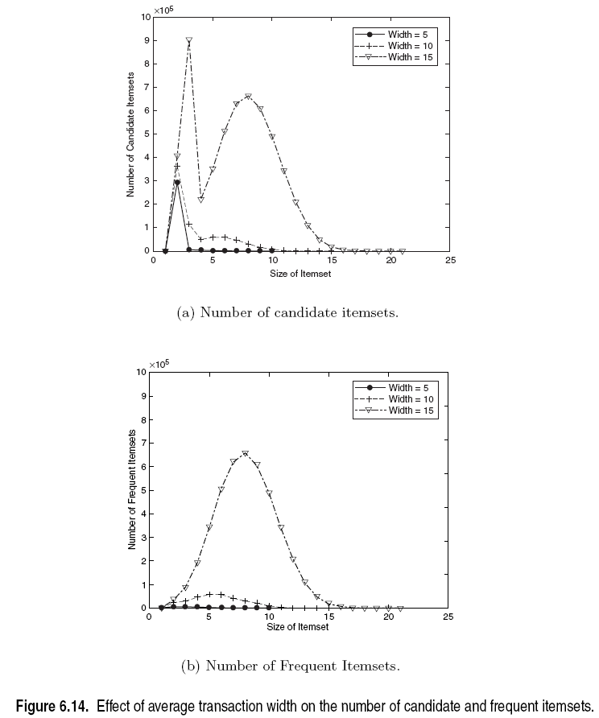
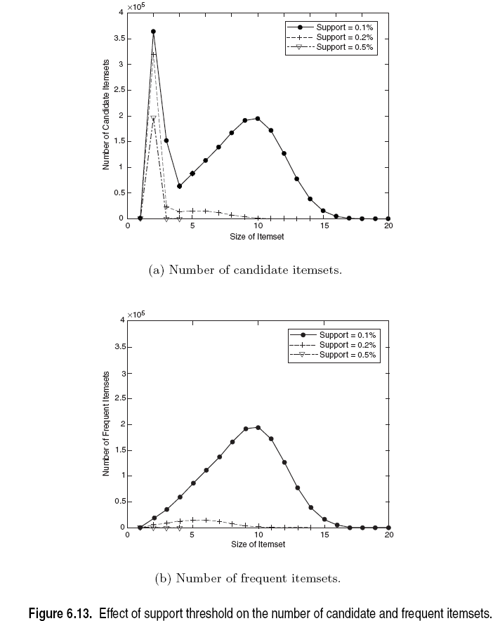
Factors Affecting Complexity of Apriori

Slide 23
Assumptions of Apriori
If an itemset is frequent, then all of its subsets must also be frequent.
Conversely, if an itemset such as {a, b} is infrequent, then all of its supersets must be infrequent too.

Slide 24
Problem with Apriori
In practice, the number of frequent itemsets produced from a transaction data set can be very large. It is useful to identify a small representative set of itemsets from which all other frequent itemsets can be derived.
Two such representations are presented in this section in the form of maximal and closed frequent itemsets.

Slide 25
Maximal Frequent Itemset
An itemset is maximal frequent if it is frequent and none of its immediate supersets is frequent
Maximal Itemsets
Infrequent Itemsets
Border
Notes:
Among the itemsets residing near the border,
{a, d}, {a, c, e}, and {b, c, d, e} are considered to be maximal frequent itemsets
because their immediate supersets are infrequent. An itemset such as {a, d}
is maximal frequent because all of its immediate supersets, {a, b, d}, {a, c, d},
and {a, d, e}, are infrequent. In contrast, {a, c} is non-maximal because one
of its immediate supersets, {a, c, e}, is frequent.

Slide 26
Maximal Frequent Itemset
Maximal frequent itemsets effectively provide a compact representation of frequent itemsets. In other words, they form the smallest set of itemsets from which all frequent itemsets can be derived.
Here there are two groups of frequent itemsets.
Frequent itemsets that begin with item a and that may contain items c, d, or e. This group includes itemsets such as {a}, {a, c}, {a, d}, {a, e}, and {a, c, e}.
Frequent itemsets that begin with items b, c, d, or e. This group includes itemsets such as {b}, {b, c}, {c, d},{b, c, d, e}, etc.
Frequent itemsets that belong in the first group are subsets of either {a, c, e} or {a, d}, while those that belong in the second group are subsets of {b, c, d, e}.

Slide 27
Maximal Frequent Itemset
Maximal frequent item sets provide a valuable representation for data sets that can produce very long, frequent item sets, as there are exponentially frequent item sets in such data. Nevertheless, this approach is practical only if an efficient algorithm exists to explicitly find the maximal frequent item sets without having to enumerate all their subsets

Slide 28
Maximal Frequent Itemset
Despite providing a compact representation, maximal frequent itemsets do not contain the support information of their subsets. For example, the support of the maximal frequent itemsets {a, c, e}, {a, d}, and {b,c,d,e} do not provide any hint about the support of their subsets. An additional pass over the data set is therefore needed to determine the support counts of the non-maximal frequent itemsets

Slide 29
An illustrative example
Items
 | A | B | C | D | E | F | G | H | I | J
1
2
3
4
5
6
7
8
9
10
Support threshold (by count) : 5
Frequent itemsets: ?
Maximal itemsets: ?
Transactions

Slide 30
An illustrative example
Items
 | A | B | C | D | E | F | G | H | I | J
1
2
3
4
5
6
7
8
9
10
Support threshold (by count) : 5
Frequent itemsets: {F}
Maximal itemsets: {F}
Support threshold (by count): 4
Frequent itemsets: ?
Maximal itemsets: ?
Transactions

Slide 31
An illustrative example
Items
 | A | B | C | D | E | F | G | H | I | J
1
2
3
4
5
6
7
8
9
10
Support threshold (by count) : 5
Frequent itemsets: {F}
Maximal itemsets: {F}
Support threshold (by count): 4
Frequent itemsets: {E}, {F}, {E,F}, {J}
Maximal itemsets: {E,F}, {J}
Support threshold (by count): 3
Frequent itemsets: ?
Maximal itemsets: ?
Transactions

Slide 32
An illustrative example
Items
 | A | B | C | D | E | F | G | H | I | J
1
2
3
4
5
6
7
8
9
10
Support threshold (by count) : 5
Frequent itemsets: {F}
Maximal itemsets: {F}
Support threshold (by count): 4
Frequent itemsets: {E}, {F}, {E,F}, {J}
Maximal itemsets: {E,F}, {J}
Support threshold (by count): 3
Frequent itemsets:
All subsets of {C,D,E,F} + {J}
Maximal itemsets:
{C,D,E,F}, {J}
Transactions

Slide 33
Another illustrative example
Items
 | A | B | C | D | E | F | G | H | I | J
1
2
3
4
5
6
7
8
9
10
Support threshold (by count) : 5
Maximal itemsets: {A}, {B}, {C}
Support threshold (by count): 4
Maximal itemsets: {A,B}, {A,C},{B,C}
Support threshold (by count): 3
Maximal itemsets: {A,B,C}
Transactions

Slide 34
Closed Itemset
Closed itemsets provide a minimal representation of itemsets without losing their support information
An itemset X is closed if none of its immediate supersets has the same support as the itemset X.
X is not closed if at least one of its immediate supersets has same support count as X.

Slide 35
Closed Itemset
An itemset X is closed if none of its immediate supersets has the same support as the itemset X.
X is not closed if at least one of its immediate supersets has support count as X.

Slide 36
Closed Itemsets
Transaction Ids
Not supported by any transactions
Notes:
From the transactions
given in this diagram, notice that every transaction that contains b also contains
c. Consequently, the support for {b} is identical to {b, c} and {b} should
not be considered a closed itemset. Similarly, since c occurs in every transaction
that contains both a and d, the itemset {a, d} is not closed
On the other
hand, {b, c} is a closed itemset because it does not have the same support
count as any of its supersets.

Slide 37
Maximal Frequent Itemsets
Minimum support = 2
Closed but not maximal
Closed and maximal
Notes:
c, d, e, ac, bc, ce, de, abc, acd,

Slide 38
Closed Frequent Itemset
An itemset is a closed frequent itemset if it is closed and its support is greater than or equal to minsup.
In the previous example, assuming that the support threshold is 40%, {b,c} is a closed frequent itemset because its support is 60%.
Algorithms are available to explicitly extract closed frequent itemsets from a given data set.

Slide 39
What are the Closed Frequent Itemsets in this Data?
(A1-A10)
(B1-B10)
(C1-C10)
Notes:
Assuming the support threshold is 20%, the total
number of frequent itemsets is 3×(25−1) = 93. However, there are only three
closed frequent itemsets in the data: ({a1, a2, a3, a4, a5}, {b1, b2, b3, b4, b5}, and
{c1, c2, c3, c4, c5}). It is often sufficient to present only the closed frequent
itemsets to the analysts instead of the entire set of frequent itemsets.

Slide 40
Example 1
Items
 | A | B | C | D | E | F | G | H | I | J
1
2
3
4
5
6
7
8
9
10
Itemsets | Support (counts) | Closed itemsets
{C} | 3
{D} | 2
{C,D} | 2
Transactions

Slide 41
Example 1
Items
 | A | B | C | D | E | F | G | H | I | J
1
2
3
4
5
6
7
8
9
10
Itemsets | Support (counts) | Closed itemsets
{C} | 3 | ✓
{D} | 2
{C,D} | 2 | ✓
Transactions

Slide 42
Example 2
Items
 | A | B | C | D | E | F | G | H | I | J
1
2
3
4
5
6
7
8
9
10
Itemsets | Support (counts) | Closed itemsets
{C} | 3
{D} | 2
{E} | 2
{C,D} | 2
{C,E} | 2
{D,E} | 2
{C,D,E} | 2
Transactions

Slide 43
Example 2
Items
 | A | B | C | D | E | F | G | H | I | J
1
2
3
4
5
6
7
8
9
10
Itemsets | Support (counts) | Closed itemsets
{C} | 3 | ✓
{D} | 2
{E} | 2
{C,D} | 2
{C,E} | 2
{D,E} | 2
{C,D,E} | 2 | ✓
Transactions

Slide 44
Why to study closed frequent itemset
Closed frequent itemsets are useful for removing some of the redundant association rules. An association rule X → Y is redundant if there exists another rule X' → Y', where X is a subset of X' and Y is a subset of Y', such that the support and confidence for both rules are identical.

Slide 45
Why to study closed frequent itemset

Slide 46
Why to study closed frequent itemset
{b} is not a closed frequent itemset while {b, c} is closed.
The association rule {b} → {d, e} is therefore redundant because it has the same support and confidence as {b, c} → {d, e}. Such redundant rules are not generated if closed frequent itemsets are used for rule generation.

Slide 47
Maximal vs Closed Itemsets
Notes:
Finally, note that all maximal frequent itemsets are closed because none
of the maximal frequent itemsets can have the same support count as their
immediate supersets.

Slide 48
Point to remember
Finally, note that all maximal frequent itemsets are closed because none of the maximal frequent itemsets can have the same support count as their immediate supersets.

